Slide 1
Lab seminar

Slide 2
Transcription factor network
To create a network with all nodes are transcription factor genes and its corresponding protein
Data:
  Position weight matrix from Transfac 2017.2
    Consists of 7,293 matrix → represent binding position of transcription protein, 1 protein can have more that 1 matrix
  Transfac gene (Ensembl ID) to matrix association data
    represent the gene that form corresponding protein
    Consists of 4,082 matrix names
    Consists of 1,230 genes
  Promoter region
    Derived from human genome reference HG38.87
    Promoter is calculated 2,000 bp upstream of first exon of a gene

Slide 3
Method:
  In-house script to generate fasta file for promoter region for 1,230 genes
  FIMO software from MEME suite to calculate binding probability of 4,082 matrices to the promoter region of 1,230 genes
    FIMO p-value set to 0.0005
    In house script to calculate q-value using FDR method and Bonferroni correction to correct the q-value, q-value threshold set to 0.0005
  In-house script to change the FIMO output to network edge table
    For example:
    Total number of source-target pairs found by FIMO: 5,798
  Merge the FIMO edge table output result with gene to matrix association data to create connected network that represent: gene becomes protein, protein regulate gene
  Filter the merged network for disconnected nodes and duplicate edges
  Output:
    filtered network with 7,079 edges
    Transcription factor protein nodes: 1,136
    Transcription factor gene nodes: 1,265
Source | Target
V_HNF3_Q6_01 | ENSG00000106006
V_FOXP3_Q4 | ENSG00000147862

Slide 4
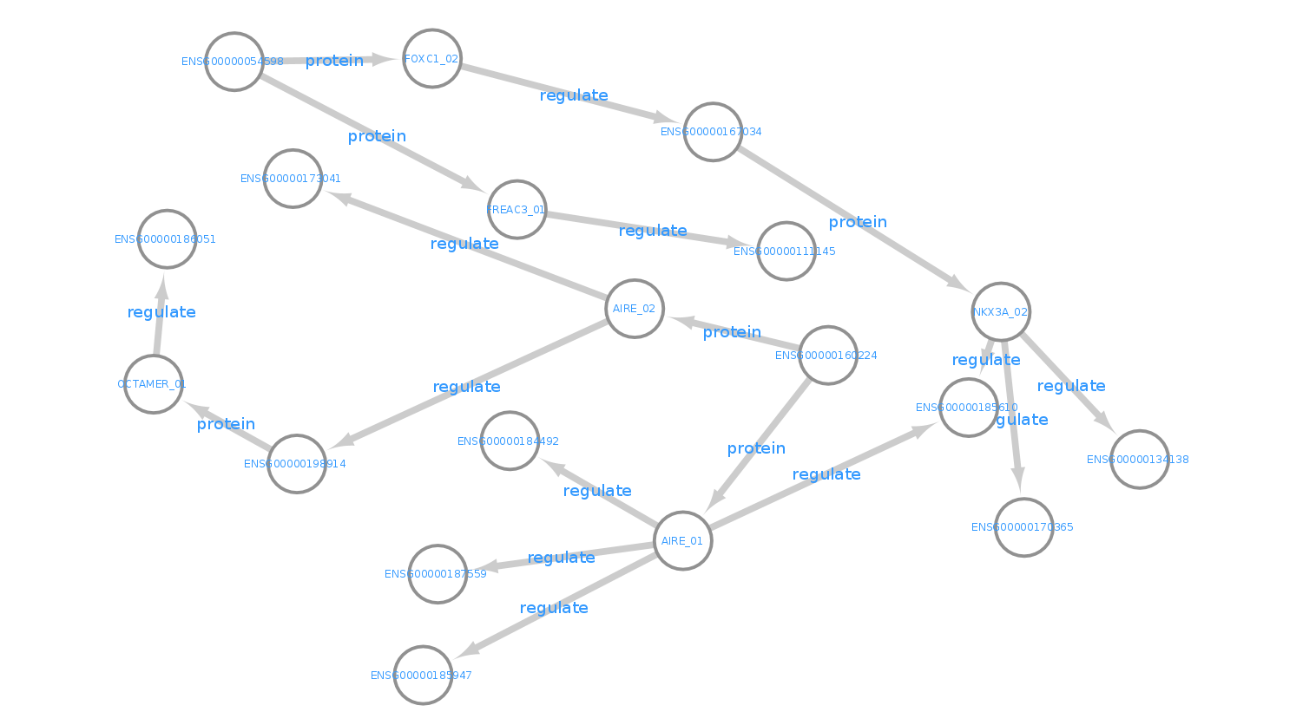
Example of one part of the result network
The edge alternate between protein and regulate.
Edge with protein label means the source is gene that form protein in the target node.
Edge with regulate label means the source is protein that regulate gene in the target node

Slide 5
Network statistics
After filter, start nodes and end nodes are all gene nodes
  Start node: gene that the protein regulator can not be found
  End node: gene that the resulted protein doesn’t regulate other gene in the network
Start nodes: 27
End nodes: 605

Slide 6
Longest path in network
No | Start gene node | Gene symbol | Longest path length
1 | ENSG00000005513 | SOX8 | 365
2 | ENSG00000054598 | FOXC1 | 355
3 | ENSG00000179348 | GATA2 | 355
4 | ENSG00000113196 | HAND1 | 353
5 | ENSG00000136944 | LMX1B | 351
6 | ENSG00000111049 | MYF5 | 349
7 | ENSG00000205250 | E2F4 | 345
8 | ENSG00000196653 | ZNF502 | 343
9 | ENSG00000170178 | HOXD12 | 343
10 | ENSG00000160224 | AIRE | 343
11 | ENSG00000186790 | FOXE3 | 341
12 | ENSG00000184486 | POU3F2 | 339
13 | ENSG00000176887 | SOX11 | 339
No | Start gene node | Gene symbol | Longest path length
14 | ENSG00000106038 | EVX1 | 339
15 | ENSG00000120075 | HOXB5 | 337
16 | ENSG00000126767 | ELK1 | 333
17 | ENSG00000106689 | LHX2 | 333
18 | ENSG00000089116 | LHX5 | 331
19 | ENSG00000129654 | FOXJ1 | 327
20 | ENSG00000170561 | IRX2 | 321
21 | ENSG00000171056 | SOX7 | 319
22 | ENSG00000197576 | HOXA4 | 317
23 | ENSG00000260596 | DUX4 | 315
24 | ENSG00000135638 | EMX1 | 315
25 | ENSG00000177606 | JUN | 305
26 | ENSG00000168875 | SOX14 | 13
27 | ENSG00000147180 | ZNF711 | 5

Slide 7
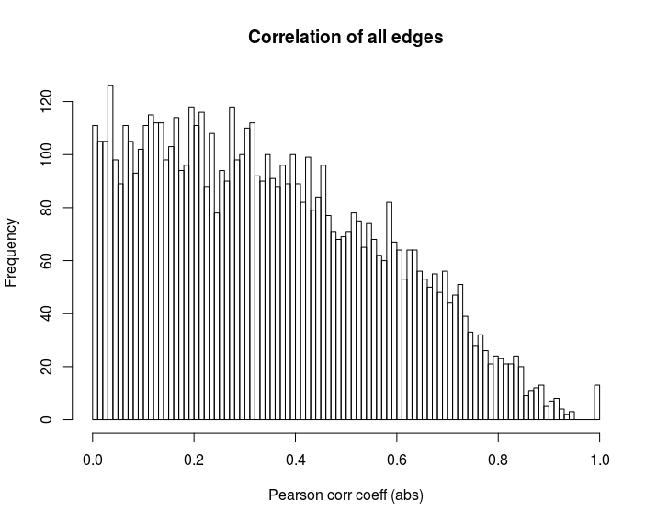

Slide 8
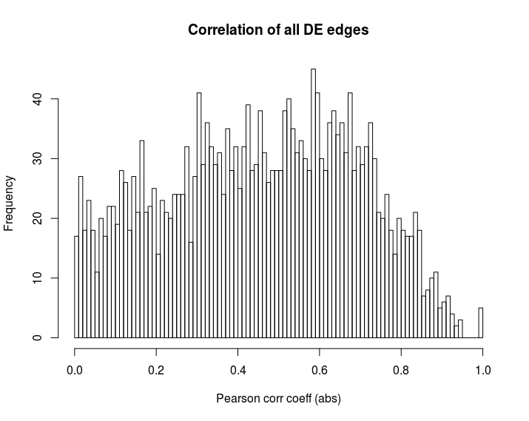

Slide 9
Protein that regulates the most DE genes
Node | Out degree
BCL6 | 282
HNF3 | 107
IRF1 | 92
FOXJ2 | 58
HFH3 | 50
All of these genes are known to be highly expressed in cancer or oncogene

Slide 10
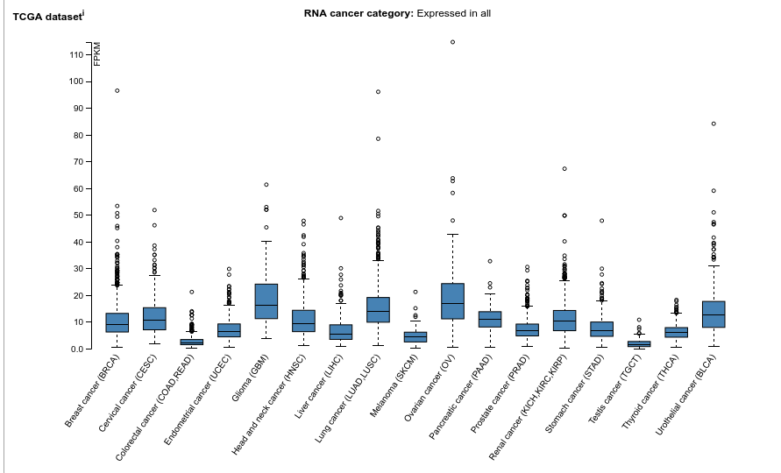
BCL6

Slide 11
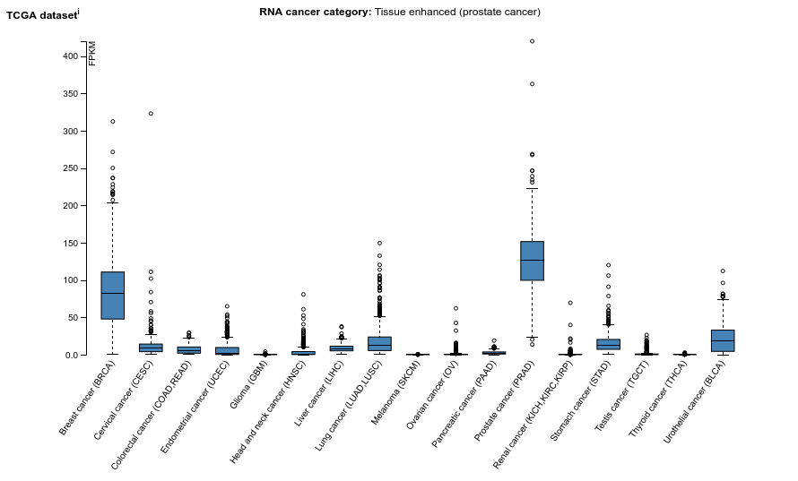
HNF3

Slide 12
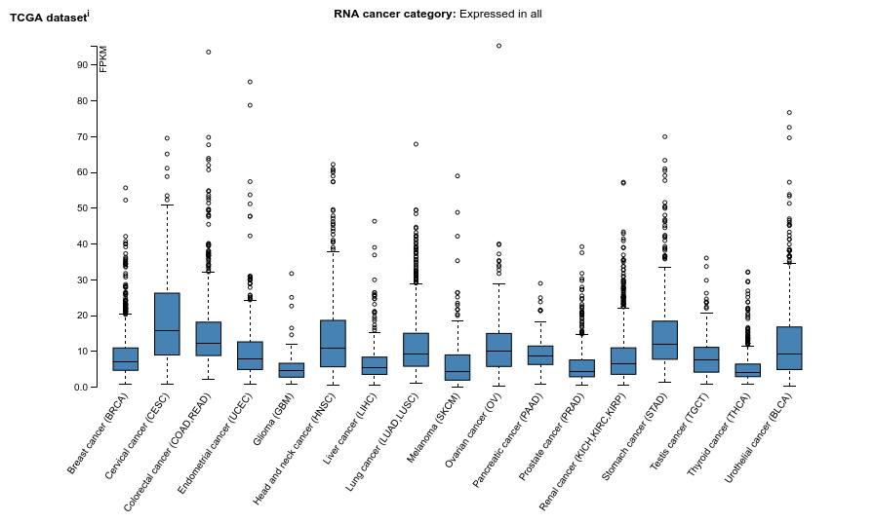
IRF1

Slide 13
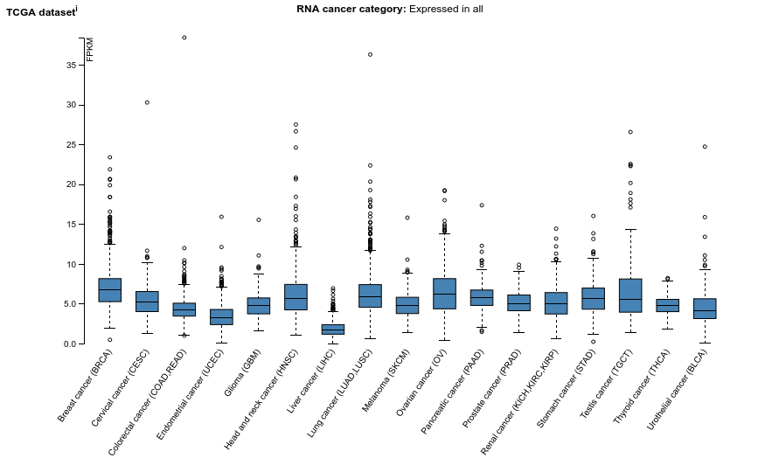
FOXJ2

Slide 14
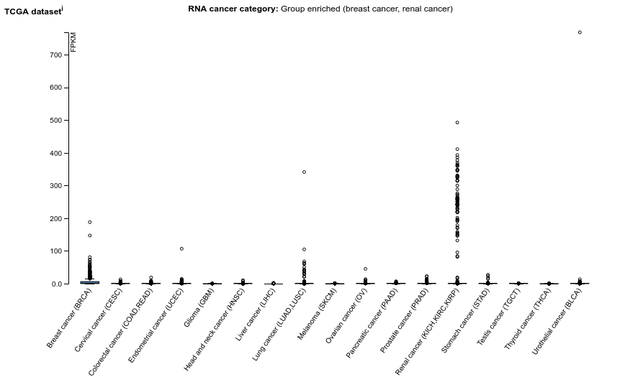
HPH3

Slide 15
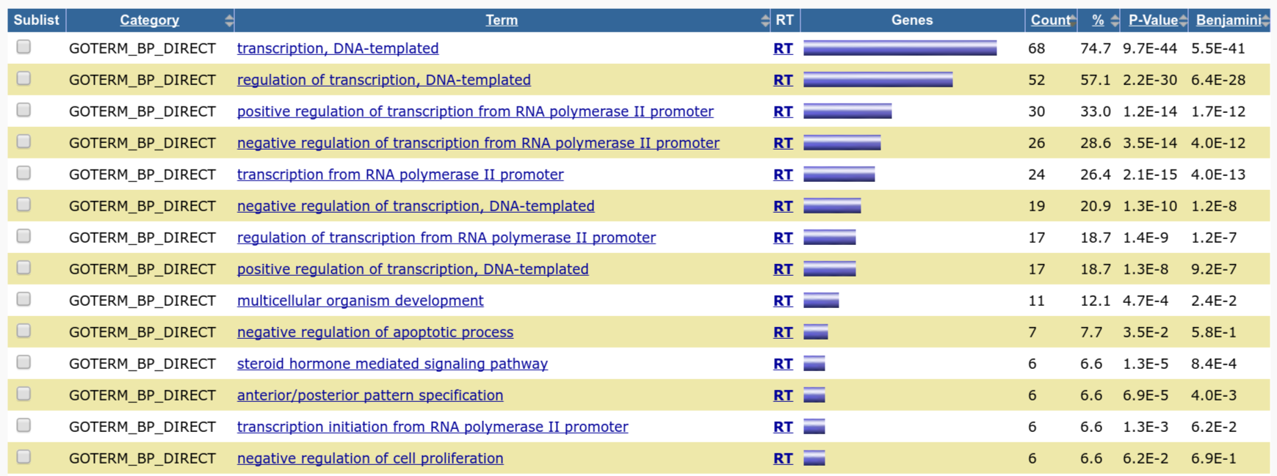
Ontology analysis for IRF1 target gene

Slide 16
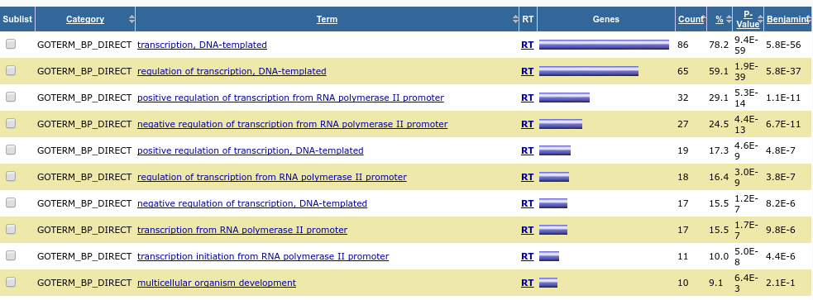
Ontology analysis for HNF3 target gene

Slide 17
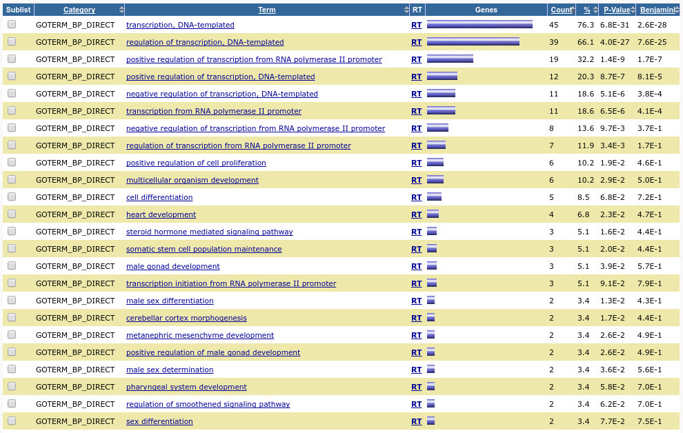
Ontology analysis for FOXAJ2 target gene

Slide 18
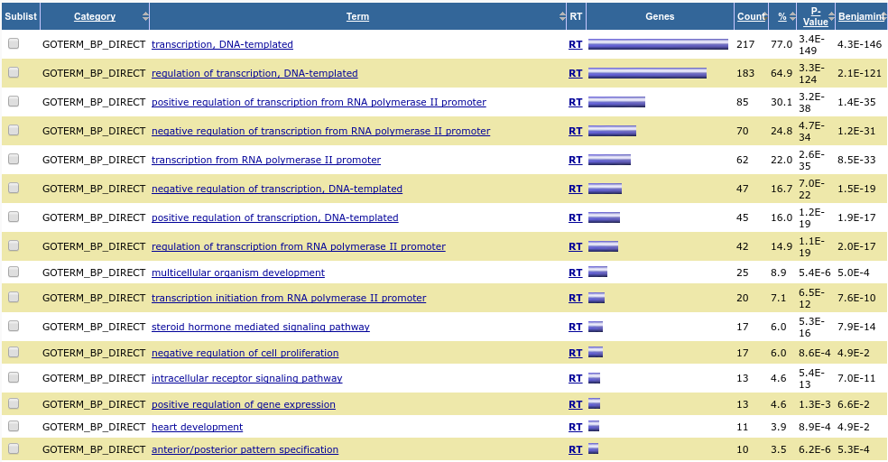
Ontology analysis for BCL6 target gene

Slide 19
Next aim
Generate other cancer dataset for DEG
  Compare the network connection
Create interface to make network inspection easier
  Web based
Future:
  Implementing network based analysis
    Causality
    Network based GO analysis

